Slide 1
Bayesian Analysis: Probability and Search
MAE 298 Yuan-Hung Lo

Slide 2
Agenda
Introduction
Implementation Example - Battleship
Real-World Application
Conclusion

Slide 3

Intro to Bayesian Search
Continuously update the probability of an event based on new evidence.
Dynamic and flexible way to handle uncertainty and progressively narrow down the search area
Prior
Likelihood
Posterior

Slide 4

Bayesian Analysis in Battleship​
Implementation Example

Slide 5
Battleship Game Overview
RULES
Finding an enemy ship on game map with guesses
Fire one shot at each step
Play until the whole ship is found and hit
APPROACH
Setup prior probability map with initial assumption
Update probability map after each hit
Adjust the probability of adjacent cells

Slide 6
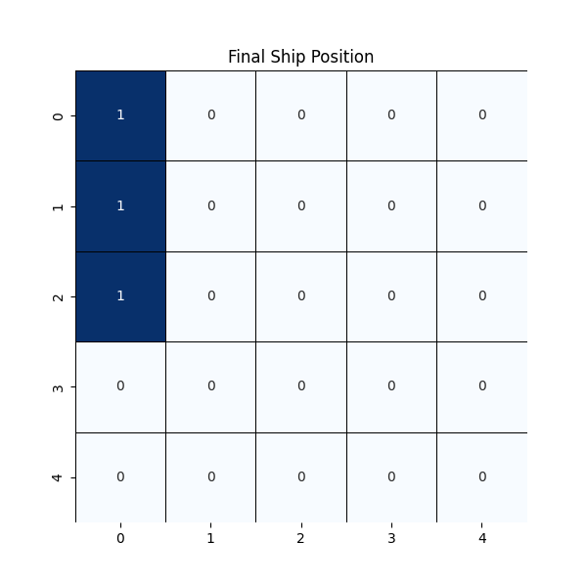
Generating Ship’s Coordinates
Randomly generate a 3x1 battleship location on a 5x5 map
Simulating a virtual opponent

Slide 7
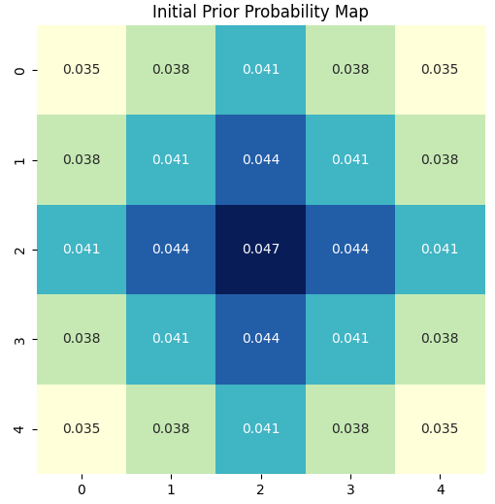
Prior Probability Map​
Assume ship is more likely to be found near the center than corners
Assert small probability difference
Initiate the search from the center

Slide 8
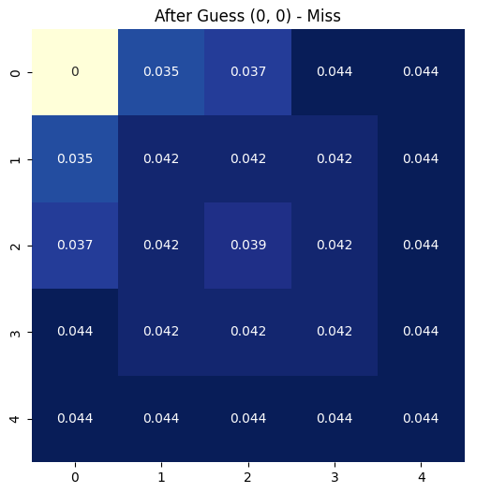
Update Map after Each Hit
MISS
Set probability to zero after cell visited
Decrease the adjacent cells’ probability if missed – 0.8x 0.9x
Next guess lands on the next cell with the highest probability

Slide 9
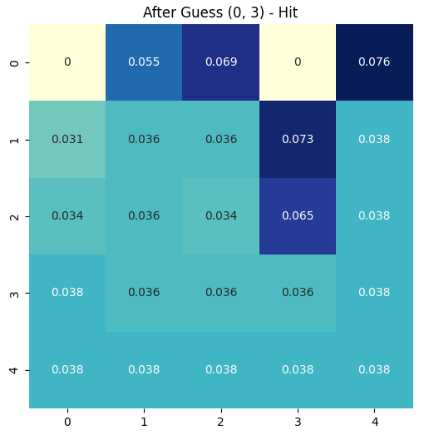
Update Map after Each Hit
HIT!
Once a shot connected, increase the adjacent cells’ probability – 2x 1.75x
Prioritize neighboring cells until the complete ship is found
Visualize state of map at each step

Slide 10
LIVE DEMO

Slide 11
Results
Takes an average of 7.43 guesses to find the ship
Assumed prior successfully increased search efficiency
Imitates game strategy of a human player
Average Number of Guesses: 7.43
Average Number of Guesses: 8.29

Slide 12
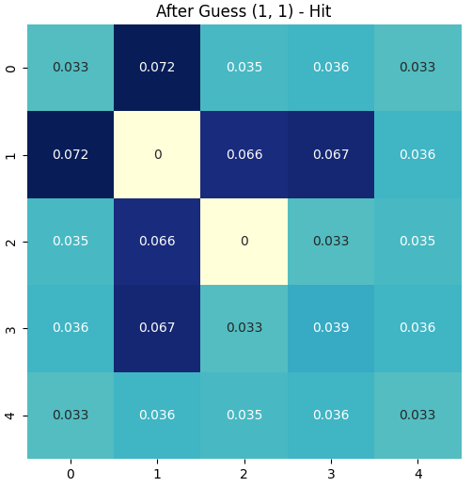
Short Comings
Judgement misled by previously missed shots
Adjust assigned probability based on neighboring cells’ state
Spend significantly more guesses in extreme cases
Against real human component
HIT!

Slide 13
Real-world Application
MH-370 Incident

Slide 14
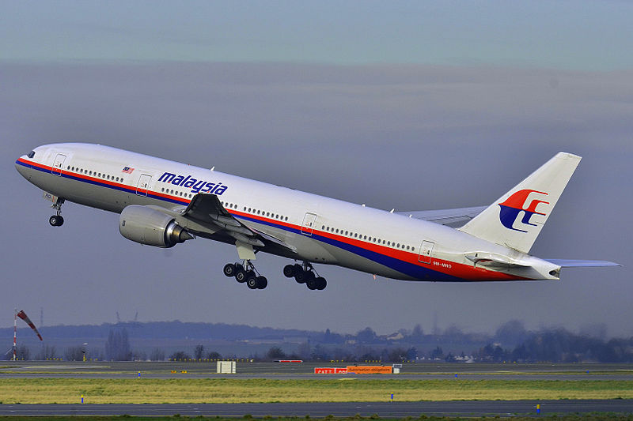
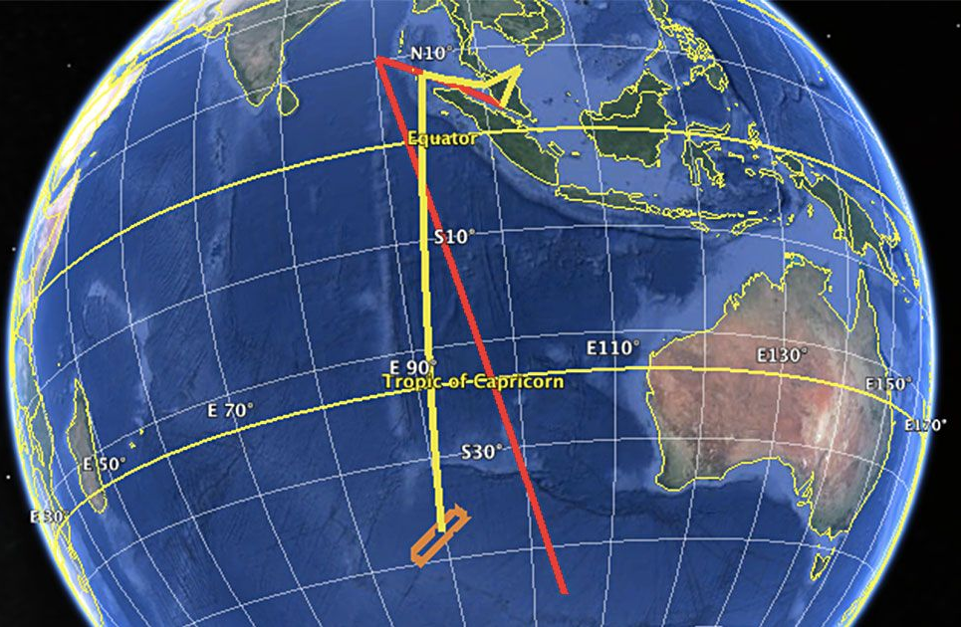
MH-370 Incident
March 8, 2014
Vast search area that extends from South China Sea to the Southern Indian Ocean
Limited initial data and information
Need for a systematic approach to update search strategies with new information

Slide 15
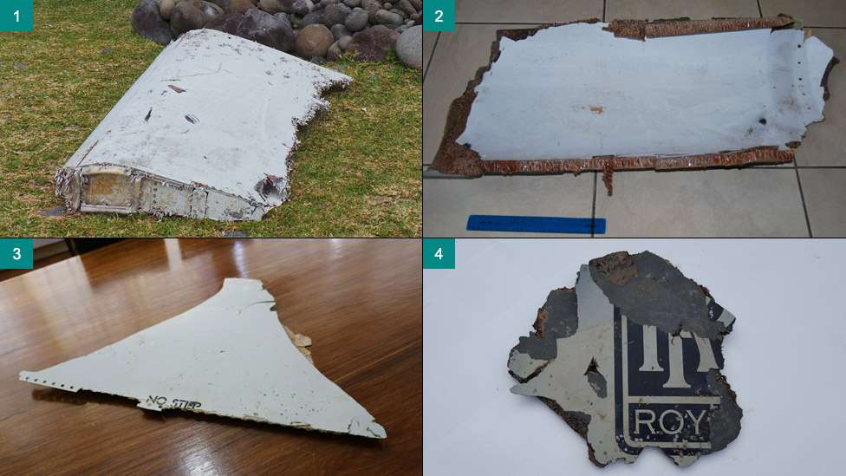
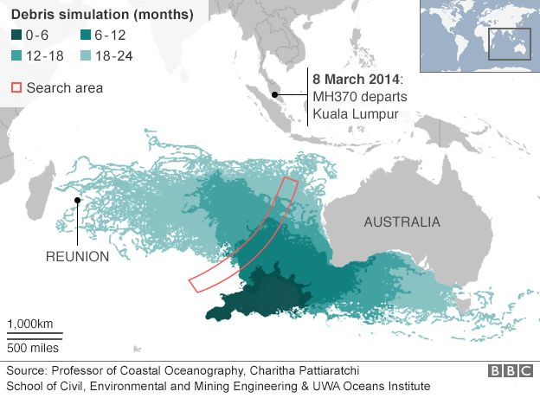
Bayesian Search Method
Prior derived from last known satellite pings and flight path
Updated likelihood based on debris findings and drift models
Focused search effort on regions with highest posterior probabilities

Slide 16

Outcomes
46,000 square miles of seabed searched
Debris findings along the coastlines confirmed the drift prediction
Provided valuable insight for future operations

Slide 17
Conclusion
Versatile and applicable to diverse scenarios
Integrates multiple data sources for better decision-making
Adapts dynamically to new information
Potential in problem solving, disaster response, healthcare, etc

Slide 18
THANK YOU
Yuan-Hung (Gary) Lo​
garylo@ucla.edu

Slide 19
Selecting visual aids
Enhancing your presentation

Slide 20
Effective delivery techniques​
Voice modulation is a powerful tool in public speaking. It involves varying pitch, tone, and volume to convey emotion, emphasize points, and maintain interest:
Pitch variation​
Tone inflection​
Volume control
Effective body language enhances your message, making it more impactful and memorable:
Meaningful eye contact
Purposeful gestures
Maintain good posture
Control your expressions

Slide 21
Navigating Q&A sessions
Know your material in advance​
Anticipate common questions​
Rehearse your responses
Maintaining composure during the Q&A session is essential for projecting confidence and authority. Consider the following tips for staying composed:​
Stay calm​
Actively listen​
Pause and reflect​
Maintain eye contact

Slide 22

Speaking impact​
Your ability to communicate effectively will leave a lasting impact on your audience​
Effectively communicating involves not only delivering a message but also resonating with the experiences, values, and emotions of those listening

Slide 23
Dynamic delivery​
Learn to infuse energy into your delivery to leave a lasting impression​
One of the goals of effective communication is to motivate your audience
Metric​ | Measurement​ | Target​ | Actual​
Audience attendance​ | # of attendees​ | 150​ | 120​
Engagement duration​ | Minutes​ | 60​ | 75​
Q&A interaction​ | # of questions​ | 10​ | 15​
Positive feedback​ | Percentage (%)​ | 90​ | 95​

Slide 24
Final tips & takeaways​
Consistent rehearsal​
Practice makes perfect, so strengthen your familiarity with the presentation​
Refine delivery style​
Pacing, tone, and emphasis​
Timing and transitions​
Aim for seamless, professional delivery​
Practice audience
Enlist colleagues to listen & provide feedback​
Seek feedback​
Reflect on performance​
Explore new techniques​
Set personal goals​
Iterate and adapt

Slide 25
Speaking engagement metrics​
Impact factor​ | Measurement​ | Target​ | Achieved​
Audience interaction​ | Percentage (%)​ | 85​ | 88​
Knowledge retention​ | Percentage (%)​ | 75​ | 80​
Post-presentation surveys​ | Average rating​ | 4.2​ | 4.5​
Referral rate​ | Percentage (%)​ | 10​ | 12​

